Slide 1
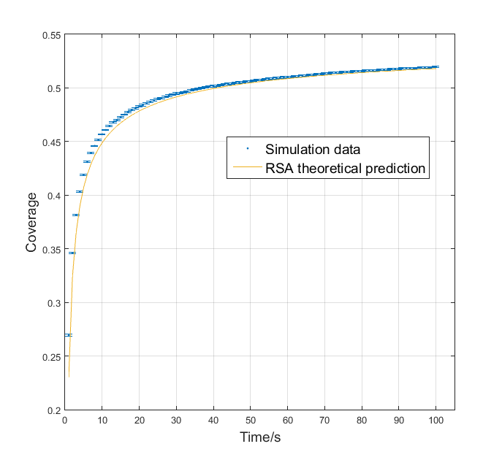
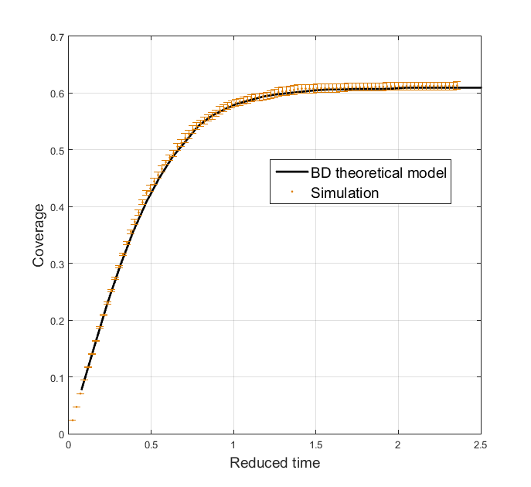
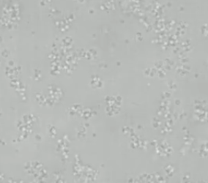
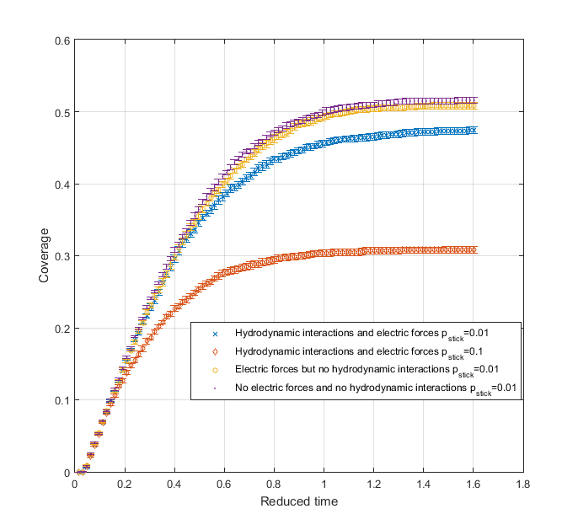

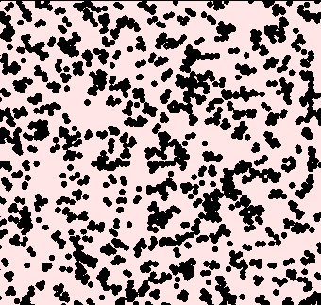
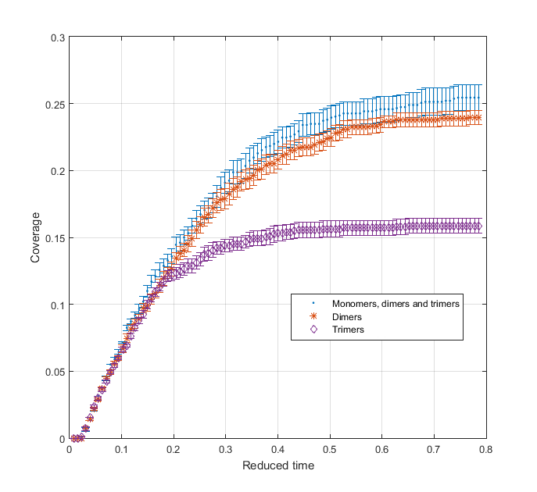
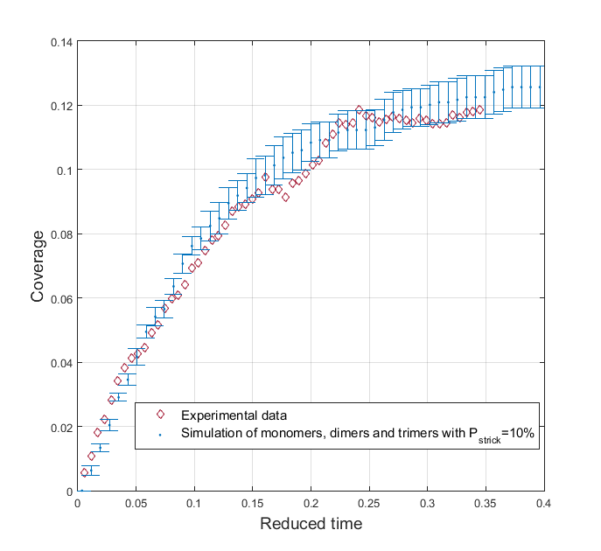
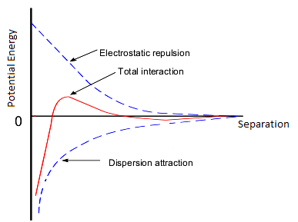
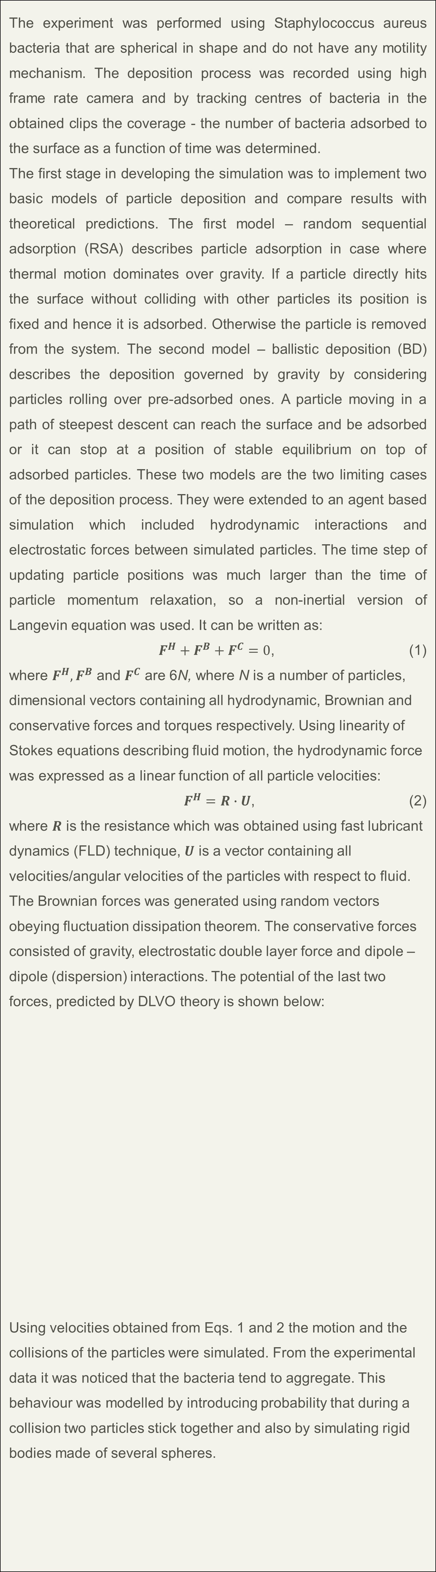
Project Title: The Growth of Bacterial Biofilms on Graphene
Justinas Rumbutis (in collaboration with Jack Hart)
Dr Thomas Waigh
Project Description
Approach / Methodology Employed
Experiments, Models, Designs Used / Developed
Results
An experiment of bacterial biofilm growth on a graphite oxide surface was performed and a simulation of the bacteria adhesion to the surface process was developed. Several theoretical models were used and by comparing results of deposition kinetics obtained by these models to the actual experimental data the dominant effects of the process were identified.
The results obtained from BD and RSA simulations were found to be consistent with theoretical predictions. The surface coverage as a function of time for these two models is given in Fig. 4 and Fig 5. The final coverages were found to be 0.6108 ± 0.0003 and 0.5500 ± 0.0001 while theory predicts 0.6105 and 0.55 for BD and RSA models respectively.
Results of simulation with/without hydrodynamic and conservative interactions and with polydispersity of particles are given in Fig. 6 and Fig. 7 respectively. The experimental result is given in Fig. 8.
The experiment was performed using Staphylococcus aureus bacteria that are spherical in shape and do not have any motility mechanism. The deposition process was recorded using high frame rate camera and by tracking centres of bacteria in the obtained clips the coverage - the number of bacteria adsorbed to the surface as a function of time was determined.
The first stage in developing the simulation was to implement two basic models of particle deposition and compare results with theoretical predictions. The first model – random sequential adsorption (RSA) describes particle adsorption in case where thermal motion dominates over gravity. If a particle directly hits the surface without colliding with other particles its position is fixed and hence it is adsorbed. Otherwise the particle is removed from the system. The second model – ballistic deposition (BD) describes the deposition governed by gravity by considering particles rolling over pre-adsorbed ones. A particle moving in a path of steepest descent can reach the surface and be adsorbed or it can stop at a position of stable equilibrium on top of adsorbed particles. These two models are the two limiting cases of the deposition process. They were extended to an agent based simulation which included hydrodynamic interactions and electrostatic forces between simulated particles. The time step of updating particle positions was much larger than the time of particle momentum relaxation, so a non-inertial version of Langevin equation was used. It can be written as:
$F^{H}+F^{B}+F^{C}=0$, (1)
where $F^{H},F^{B}$ and $F^{C}$ are 6N, where N is a number of particles, dimensional vectors containing all hydrodynamic, Brownian and conservative forces and torques respectively. Using linearity of Stokes equations describing fluid motion, the hydrodynamic force was expressed as a linear function of all particle velocities:
$F^{H}=R∙U$, (2)
where $R$ is the resistance which was obtained using fast lubricant dynamics (FLD) technique, $U$ is a vector containing all velocities/angular velocities of the particles with respect to fluid. The Brownian forces was generated using random vectors obeying fluctuation dissipation theorem. The conservative forces consisted of gravity, electrostatic double layer force and dipole – dipole (dispersion) interactions. The potential of the last two forces, predicted by DLVO theory is shown below:
Using velocities obtained from Eqs. 1 and 2 the motion and the collisions of the particles were simulated. From the experimental data it was noticed that the bacteria tend to aggregate. This behaviour was modelled by introducing probability that during a collision two particles stick together and also by simulating rigid bodies made of several spheres.
Project Objectives / Deliverables
The main objective of this project was to develop a simulation capable of predicting experimental results. Several methods were used and several versions of the simulation were developed. A real and a simulated image of bacterial depositions are given below.
Fig. 4. Surface coverage as a function of time of RSA simulation.
Fig. 5. Surface coverage as a function of time of BD simulation.
Figure 1. An experimentally obtained image of bacteria
deposition.
Fig. 6. Surface coverage as a function of time obtained with and without particle interactions using two different sticking probabilities.
Figure 2. An image of simulated deposition.
Fig. 7. Surface coverage as a function of time of polymer simulation.
References
[1] Carla, Ph., Schxccmittbuhla, M., Schaafb P., Stoltzc, J.-F., Voegela, J.-C., Senger, B., Experimental and Modeled Deposition Kinetics of Large Colloidal Particles, Elsevier, 2001.
[2] Mazza, M., G., The Physics of Biofilms—an Introduction, Journal of Physics D: Applied Physics, 49,20, 2016.
[3] Schunk, P. R., Higdon, J., Chen, S., Next Generation Suspension Dynamics Algorithms, University of Illinois Urbana Champagne, 2014.
[4] Privman, V., Recent Theoretical Results of Nonequilibrium Deposition of Submicron Particles, Department of Physics, Clarkson University, Potsdam, 2000.
[5] Bolintineanu, D. S., Grest, G. S., Lechman, J. B., Pierce, F., Plimpton, S. J., Schunk, P. R., Particle dynamics modeling methods for colloid suspensions, Computational Particle Mechanics, 1,3, 321–356, 2014.
[6] Baraff D., Fast Contact Force Computation for
Nonpenetrating Rigid Bodies, Robotics Institute Carnegie Mellon University Pittsburgh, 1994.
[7] Baraff D., Rigid Body Simulation I—Unconstrained Rigid Body Dynamics, Robotics Institute Carnegie Mellon University Pittsburgh, 1997.
[8] Delong, S., Usabiaga, F. B., Donev, A., Brownian dynamics of confined rigid bodies, J. Chem. Phys. 143, 144107, 2015.
[9] MATLAB, Version R2015, The Math Works Inc, Natick, Mass 01760.
Fig. 8. Experimental data of surface coverage as a function of time and results of simulation of polydisperse particles.
Fig. 3. Electrostatic double layer and dipole-dipole interaction potentials
Overall Findings / Conclusions
By comparing the experimental data to the simulation results it was found that in BD and RSA models of spherical particles can not predict kinetics of bacterial deposition when both thermal motion and gravity are equally important. Also it was observed that other effects, especially bacterial aggregation, are important in modelling the adsorption process. The closest result to the experimental data was obtained by simulating equal amounts of monomer, dimer and trimer particles with sticking probability of 10%.

